Slide 1
Test environment for WEB APP
By Andrii Rudyi

Slide 2
About me
Information Security Training
me
Healthy sleep, healthy food,
relationships, career growth,
self-development, sport

Slide 3
Learn to work with Packer, Vagrant, Visual Studio, MS SQL, IIS and etc.
Create website on .NET
Create UML diagram
Emulation of development environment
Full automation of the deployment process environment
GOALS

Slide 4
TECHNICAL STACK
Dev Tools: 1. ASPNET and Web Tools 2019 (version 16.0.12313.64372) 2. MS Visual Studio Community 2019 3. MS SQL Server (version 17.9.1) Environment Tools: 1. Git (version 2.21.0) 2. Packer (version 1.3.5)
3. Vagrant (version 2.2.4)
4. VirtualBox (version 6.0.6)
5. Windows Server 2016 x64
6. MS SQL SMS (version 18.0)
7. Sublime text (version 3.2.1) 8. Internet Information Services (version 10.0.14393.0) 9. PowerShell (version 5.1.17134.590)

Slide 5
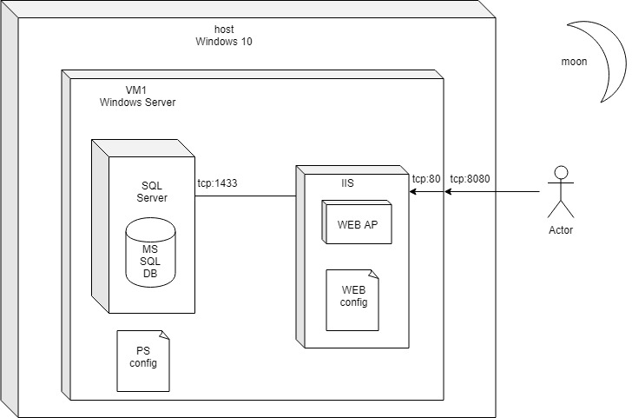
UML DEPLOYMENT DIAGRAM

Slide 6
Completed tasks
Script creation for Packer
Vagrant file created and editing.
Script preparing for automation deployment IIS, SQL, Web App. 4. UML diagram created.
5. Documentation and GUID is created.

Slide 7
References
https://www.packer.io/
https://www.vagrantup.com/
https://professorweb.ru
https://www.draw.io/
https://github.com/joefitzgerald/packer-windows
https://docs.microsoft.com
https://visualstudio.microsoft.com/
https://metanit.com/sharp/aspnet5/20.1.php
https://chocolatey.org/docs/helpers-update-session-environment
https://docs.microsoft.com/en-us/powershell/module/webadminstration/new-webapplication?view=winserver2012-ps
https://github.com/dmitiyoleynik/GameStore
thank you

Slide 8
THANK

